Slide 1


Dealer Meeting
10/11/2022
    AGENDA
    DEUS II Key Features
    DEUS II WS6 MASTER
    DEUS II Line up
    DEUS / ORX Line up
    Questions & answers

Slide 2
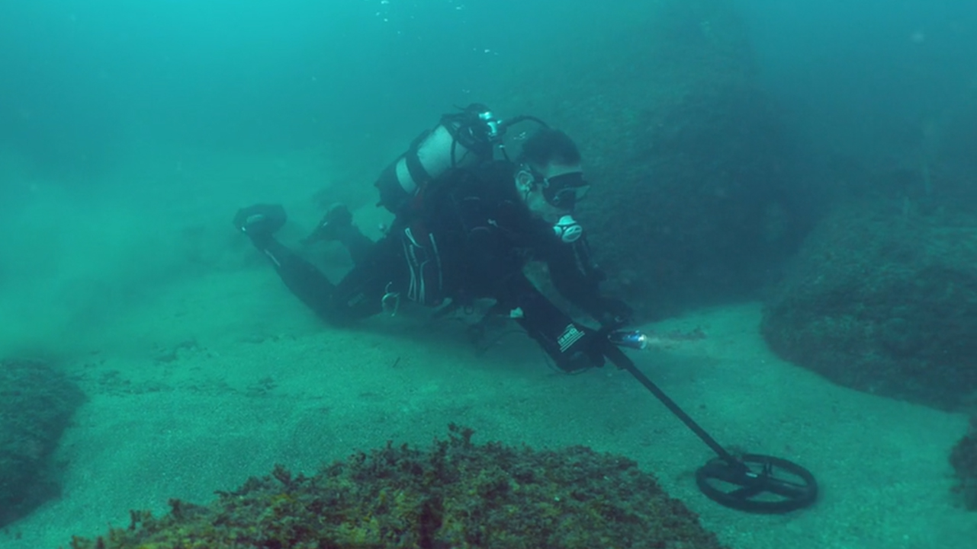

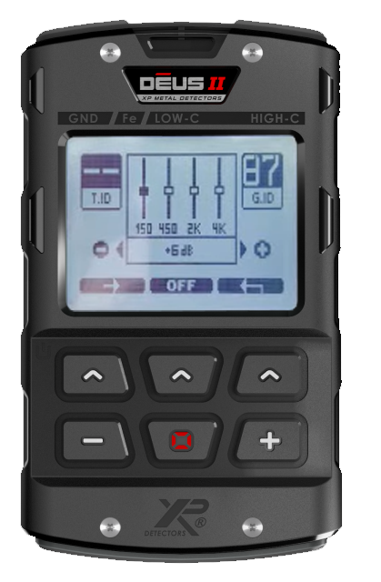

Key Features
A real Fast and simultaneous Multi Frequency
Rich audio options (4* sounds, 4 band equalizer)
Waterproof up to 20m/66ft deep (IP68, BH-01)
The lightest in the world, the most ergonomic
And still Fully Wireless!

Slide 3
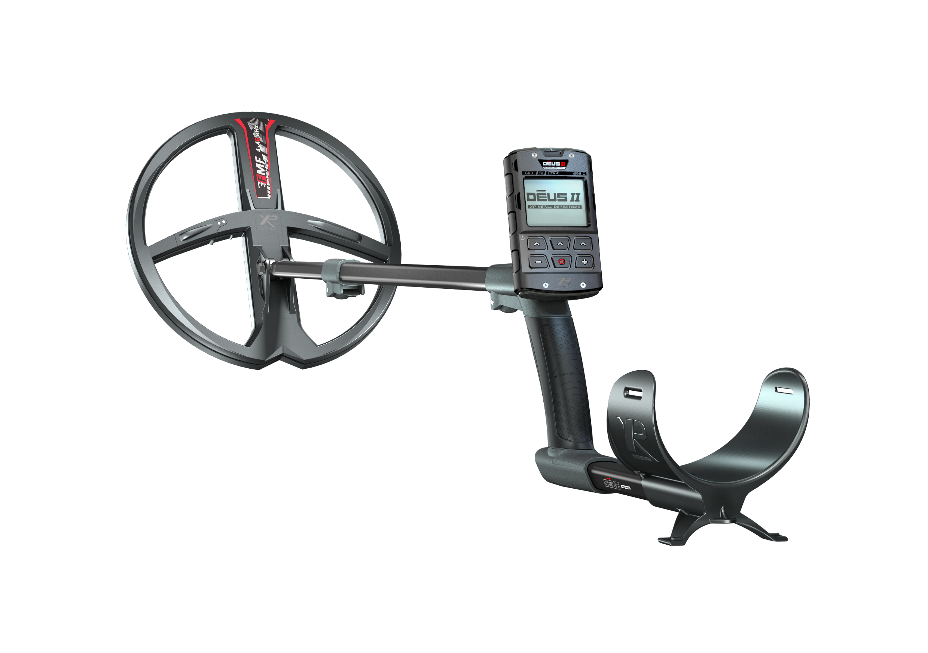












eXPlore like never before
3 FMF Coils
Simultaneous FMF
Fast Wireless
XP Link
Update
Lightness
Pinpointer Connected
Lithium
batteries
Waterproof
IP-68
Shockproof
24 Programs
Built to last
All Terrain

Slide 4

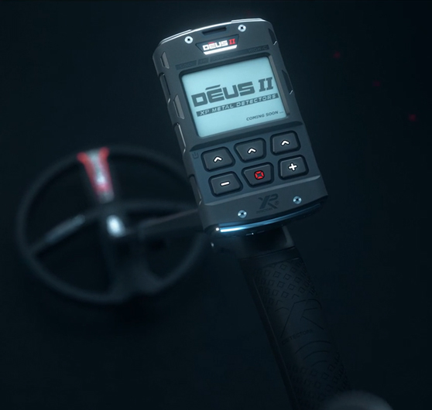
models
DEUS II FULL
DEUS2-22FMF RC WS6 (22cm/9”)
DEUS2-28FMF RC WS6 (28cm/11”)
DEUS II RC
DEUS2-22FMF RC (22cm/9”)
DEUS2-28FMF RC (28cm/11”)
DEUS II WS6 MASTER
DEUS2-22FMF WS6 (22cm/9”)
DEUS2-28FMF WS6 (28cm/11”)

Slide 5
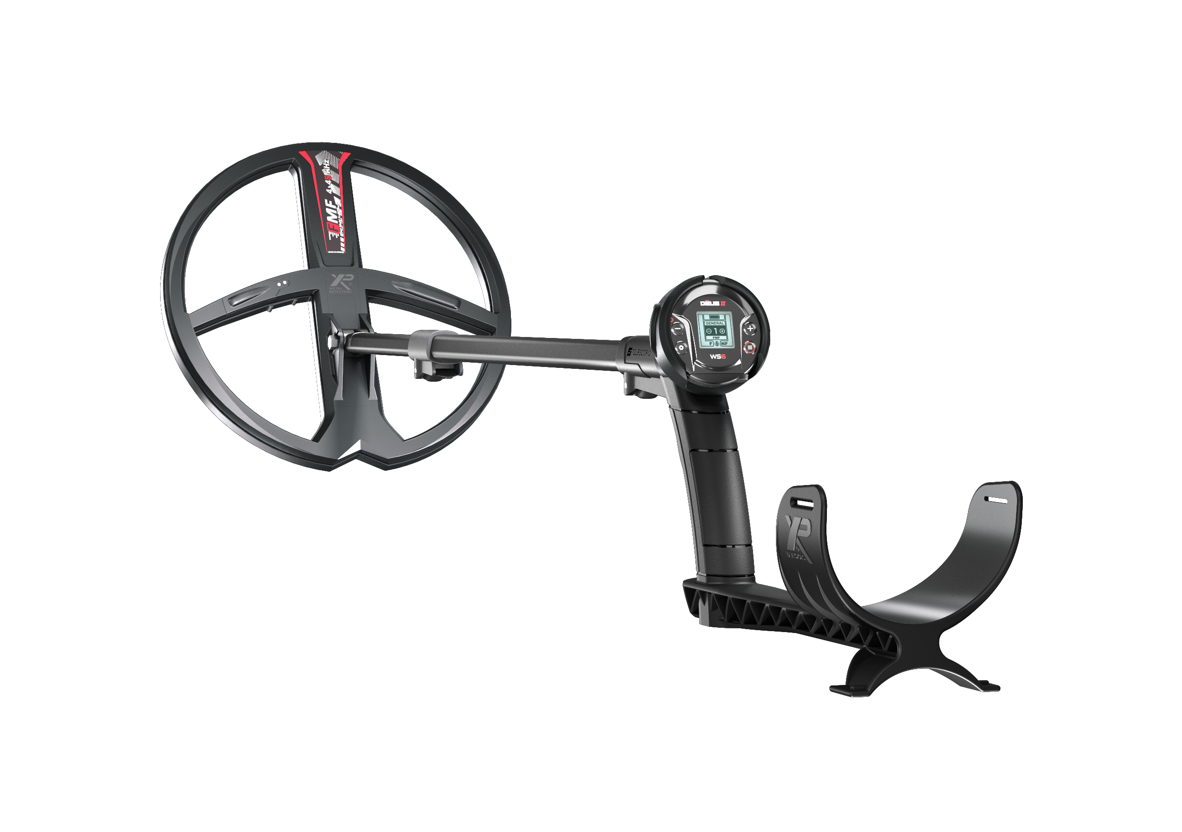
WS6 MASTER
DEUS2-22FMFWS6
DEUS2-28FMFWS6
Composed by:
  Ergonomic and S-TELESCOPIC Stem LITE
  D22FMF or D28FMF coil
  DEUS II WS6 Headphones
  D099 jack adapter
  D090B-A Stem support
899 € MSRP / US$ 899 MAP

Slide 6

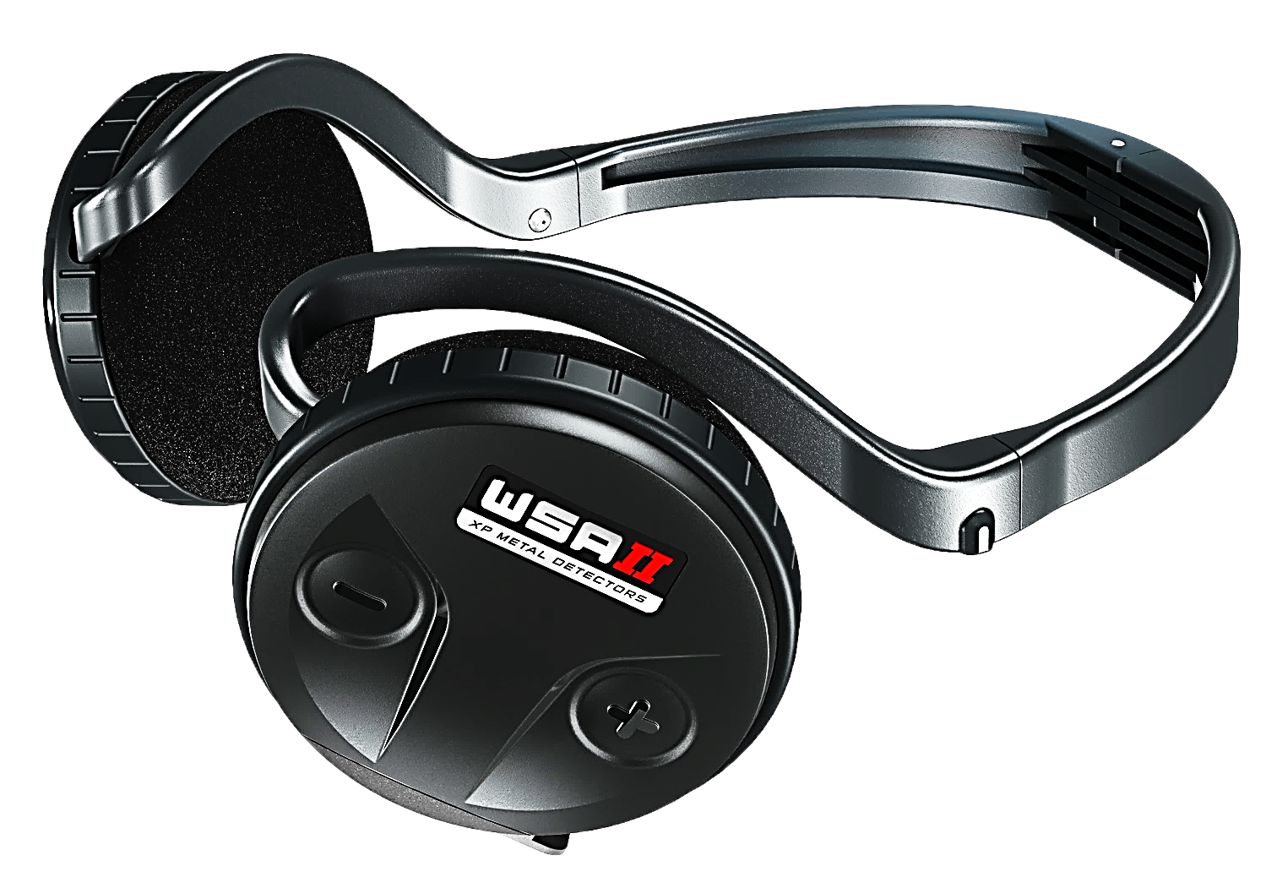
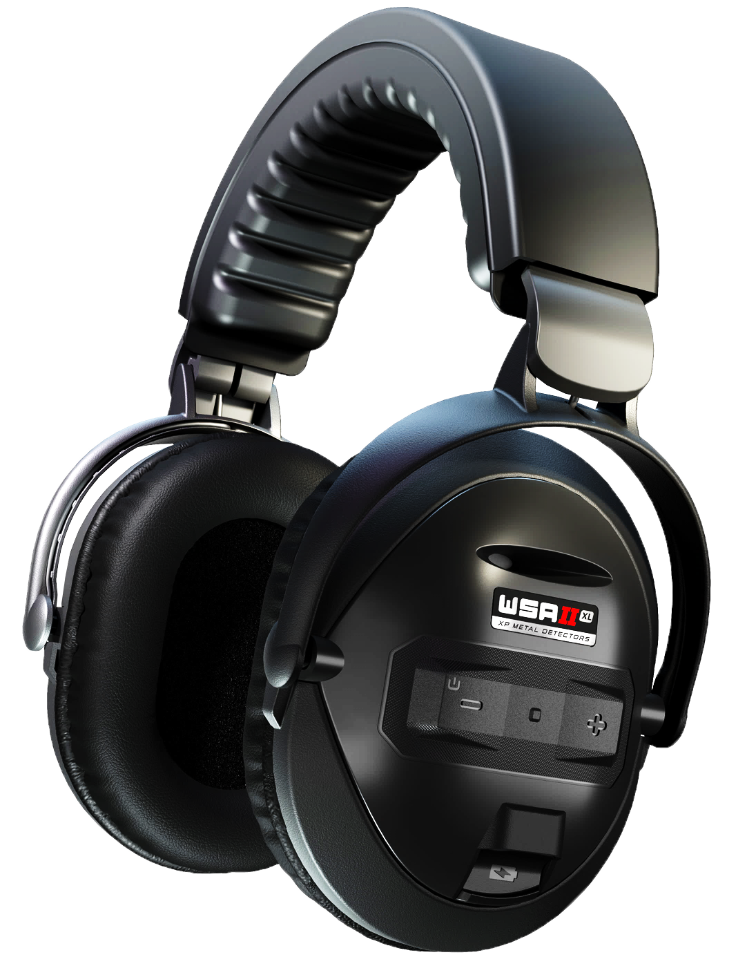
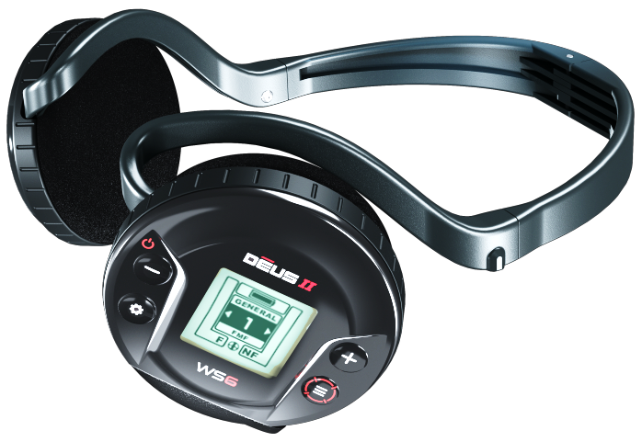
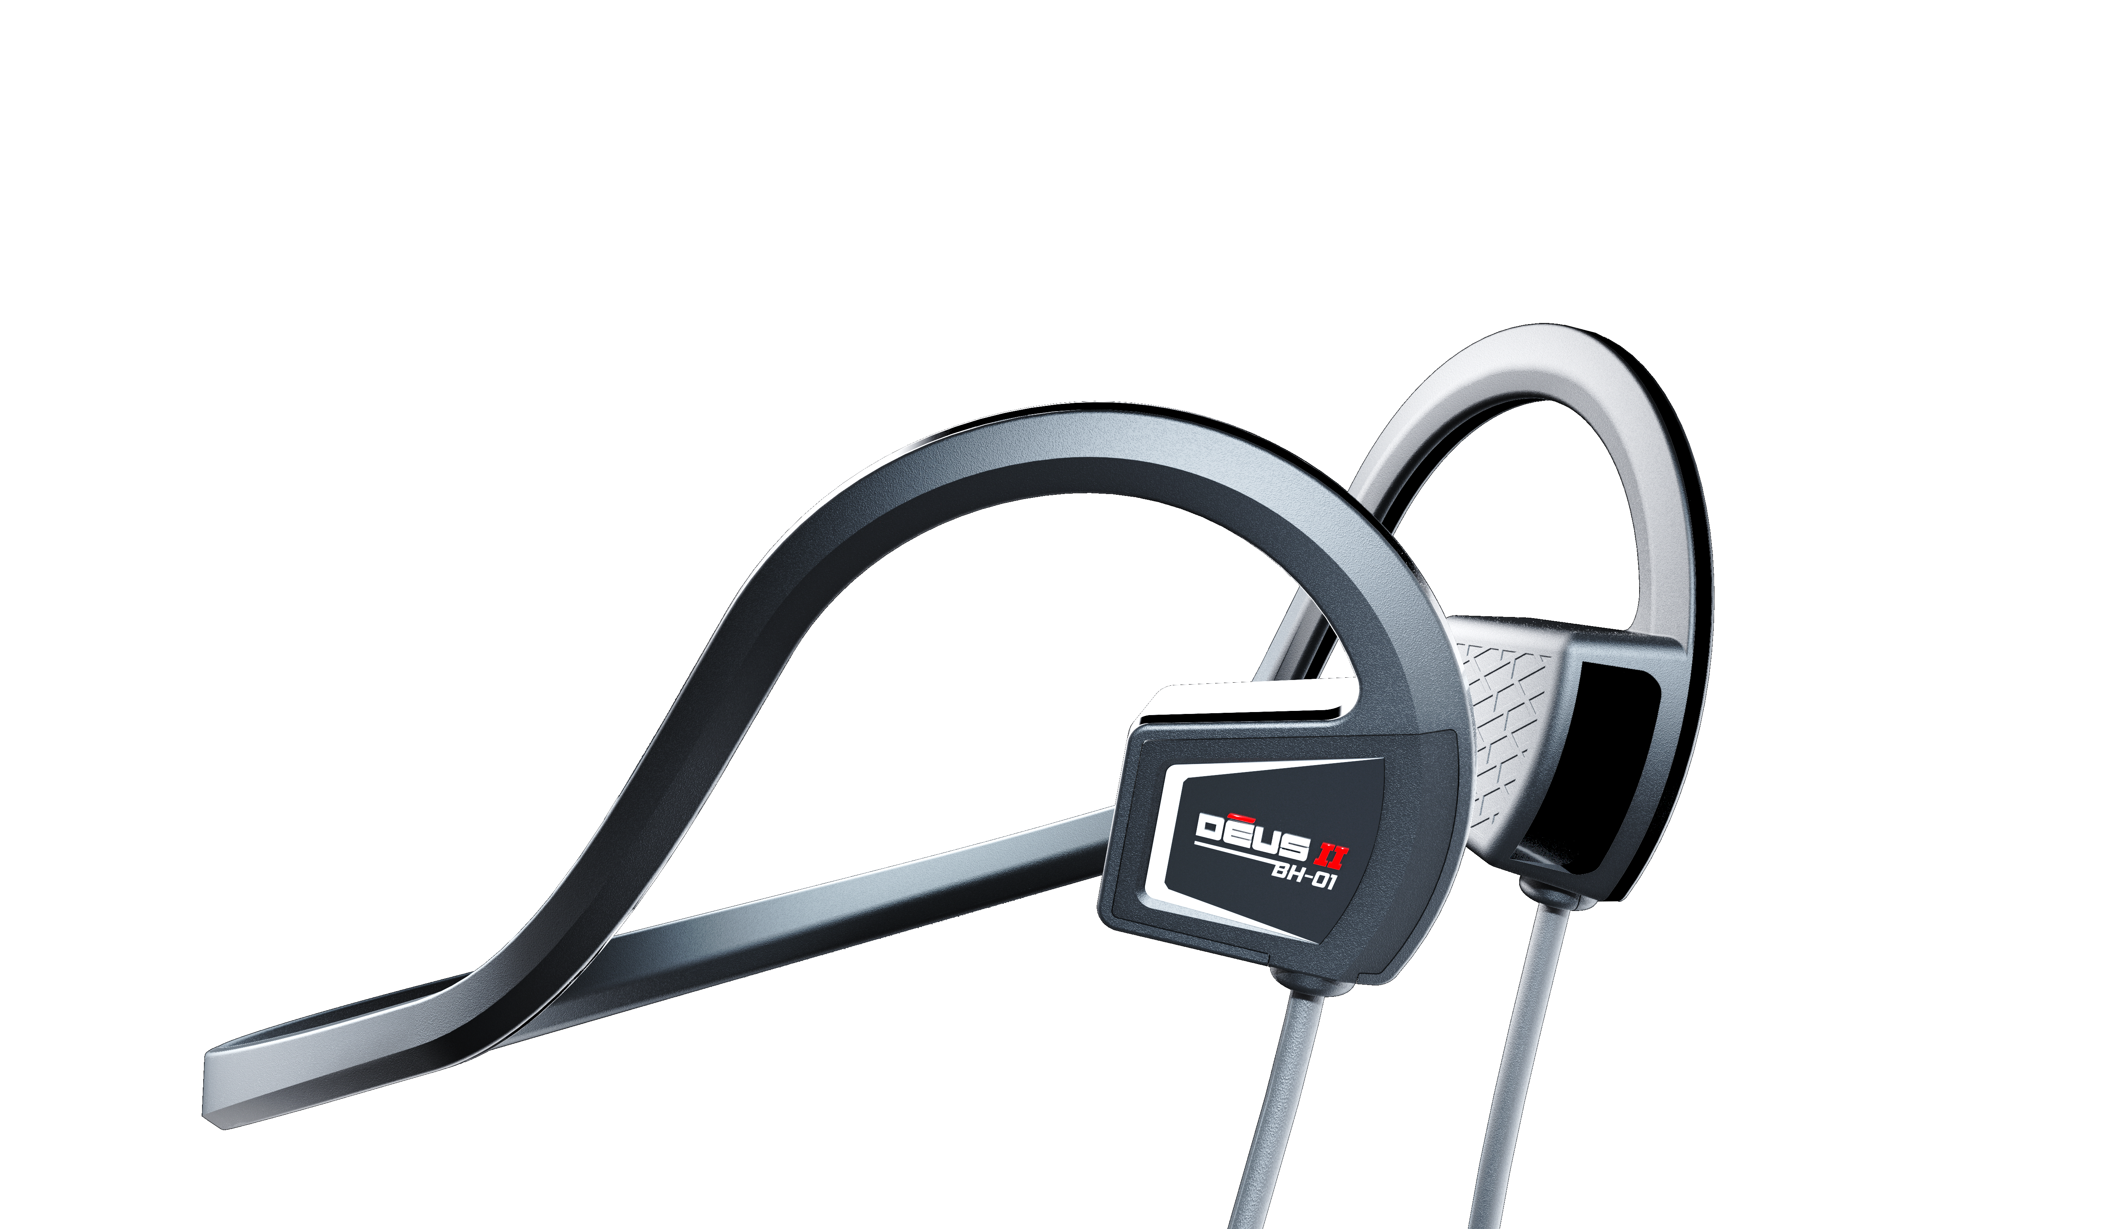
headphones
              WSA II
              WSA II-XL
              WS6
              BH-01
10
TIMES FASTER
THAN LOW LATENCY
BLUETOOTH

Slide 7
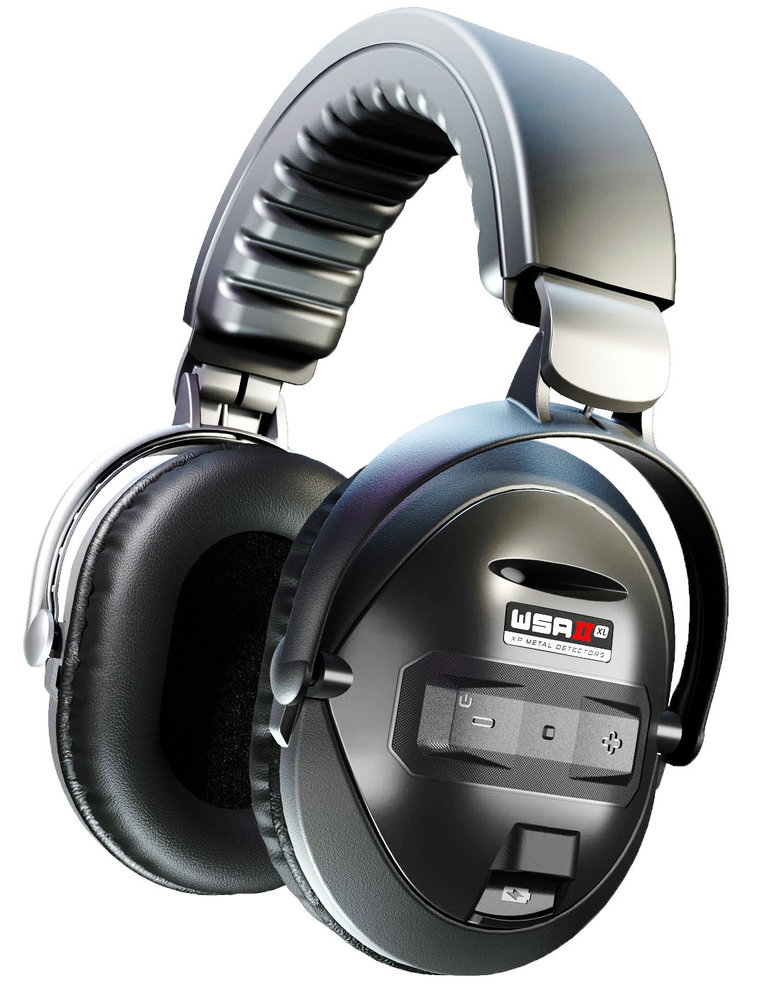
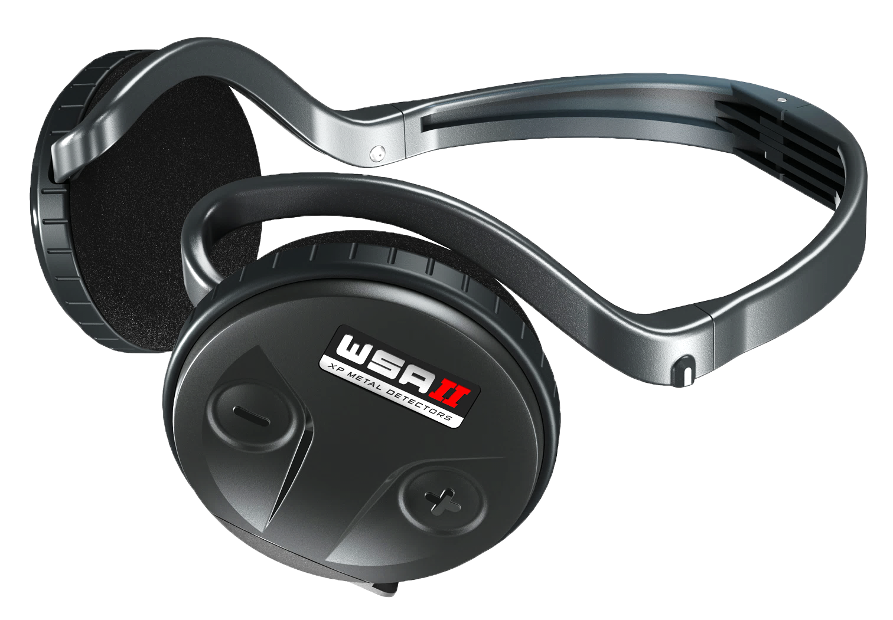
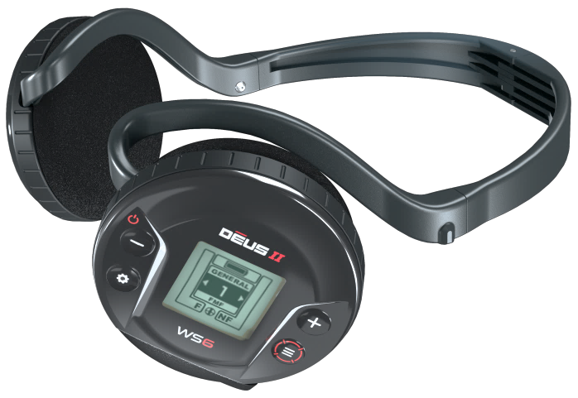
make your own bundles
DEUS II RC + WSA II or WSA II-XL or WS6
+
DEUS II WS6 + WSA II or WSA II-XL or WS6
+

Slide 8
Bundle differences
Models Features | DEUS II RC | DEUS II WS6 MASTER
Performances | The same because they use the same coils and same settings
Settings | Exactly the same except Multinotch
Different modes | The same except the X/Y Screen
Features | Waterproof | Rainproof (waterproof with DKIT-C)
Weight | From 815gr | From 750gr
Price | From 1299 €/$ | From 899 €/$
PPP
P
PP
PPP
PP
PPP

Slide 9
BECOME THE MASTER!
Find below all information about DEUS II WS6 MASTER
and BECOME THE MASTER of your sales!
XP website Link ( available in French, English and Spanish )
DEUS II WS6 MASTER product page
WSA II, WSA II-XL and all accessories…
WS6 MASTER Assets ( logos, pictures, presentation, tuto… )
All XP Assets
Our Youtube channel
  DEUS II video
  DEUS II Remote control video
  WSA II, WSA II-XL video

Slide 10

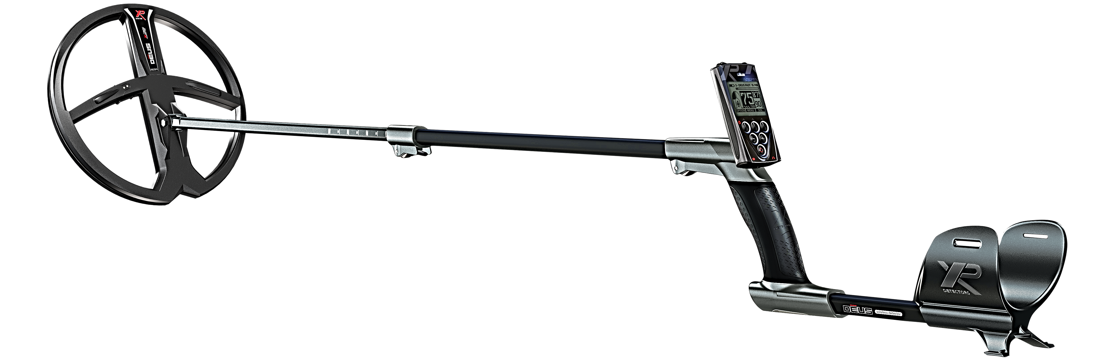
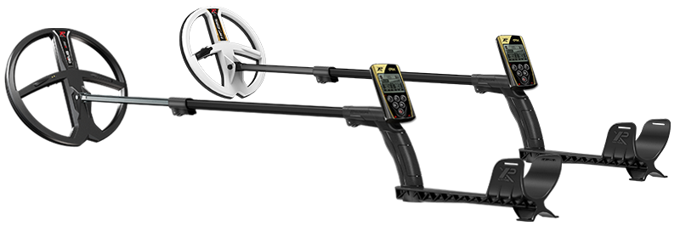
and
evolution
DEUS-22X35RC
DEUS-28X35RC
DEUS-22X35WS4 *** New
DEUS-28X35WS4 *** New
Add WSAUDIO, WS4 or WS5 by yourself
ORX-22X35RC
ORX-28X35RC
ORX-22HFRC
ORX-ELLRC
Add WSAUDIO by yourself

Slide 11
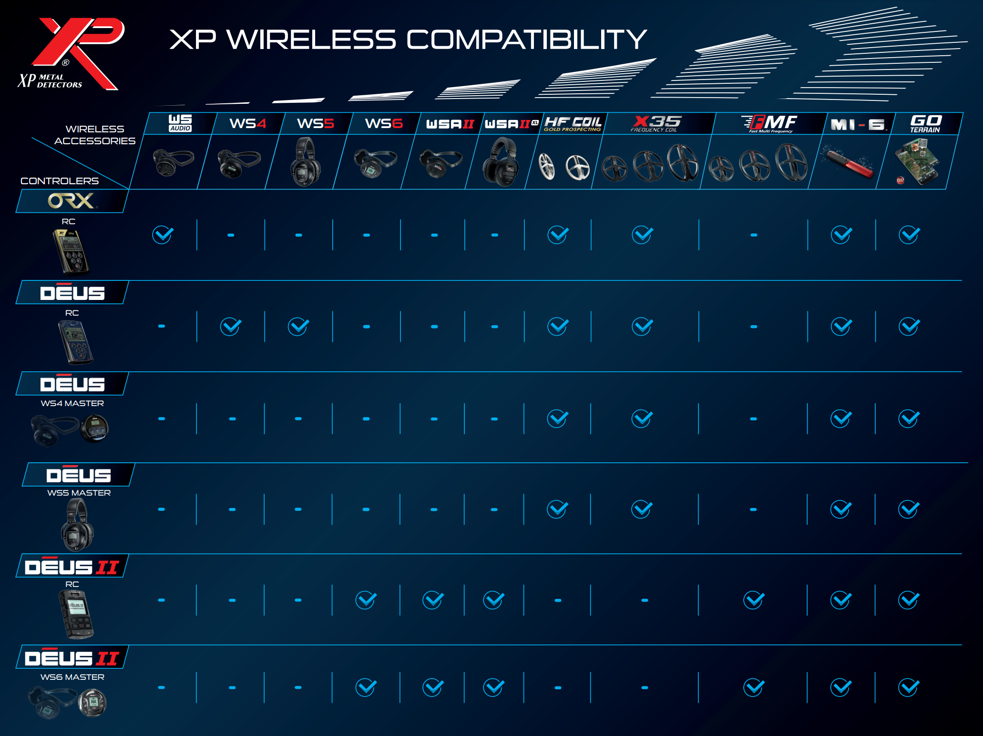

Link

Slide 12


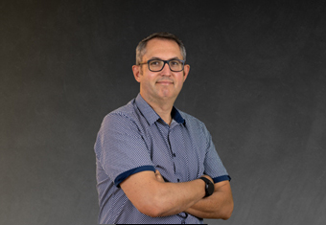
Our eXPerts
at your service
Regis – Marketing manager
r.tesseyre@xpmetaldetectors.com
Jean – Service manager
Sav2@xpmetaldetectors.com
Philippe – Business manager
p.colin@xpmetaldetectors.com

Slide 13
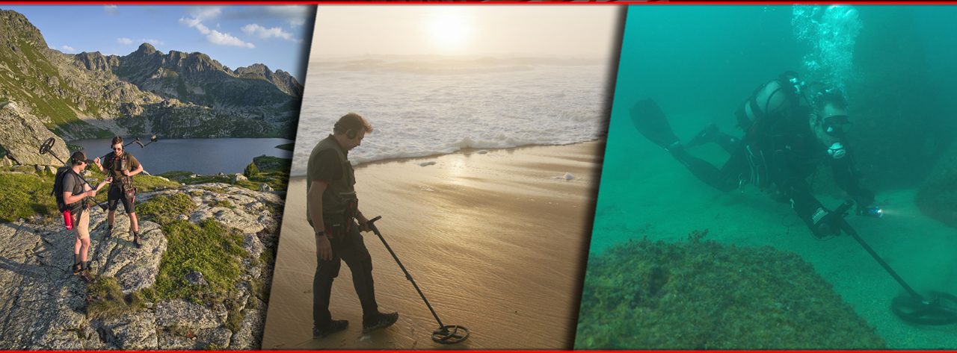
Q&A
eXPlore like never before !

